Slide 1
Testng project
Testng Project For Parallel Execution Of Test Cases

Slide 2
TEstng
TestNG is one of the most widely used open source testing framework used in automation testing suite.
Cedric Beust is the developer of a TestNG framework.
TestNG framework came after Junit, and TestNG framework adds more powerful functionality and easier to use.
It is an open source automated TestNG framework. In TestNG, NG stands for "Next Generation".

Slide 3
Testng for parallel execution
TestNG allows to run tests parallelly or in separate threads.
Parallel testing is used heavily with Selenium because of the importance of cross-browser testing.
With so many browsers in market today with a different version, create a browser matrix and run the tests parallelly.
This will save us lot of time and other resources.

Slide 4
My project
I will be giving demo of a project where I have run 10 testcases parallel on 4 different windows of Amazon.in.
I have created 4 different classes in a package “amazontest”
1.Login
2.SearchForProduct
3.AddTocart
4.BuyProduct
Also created one XML file to execute test cases “AmazonTest.xml”

Slide 5
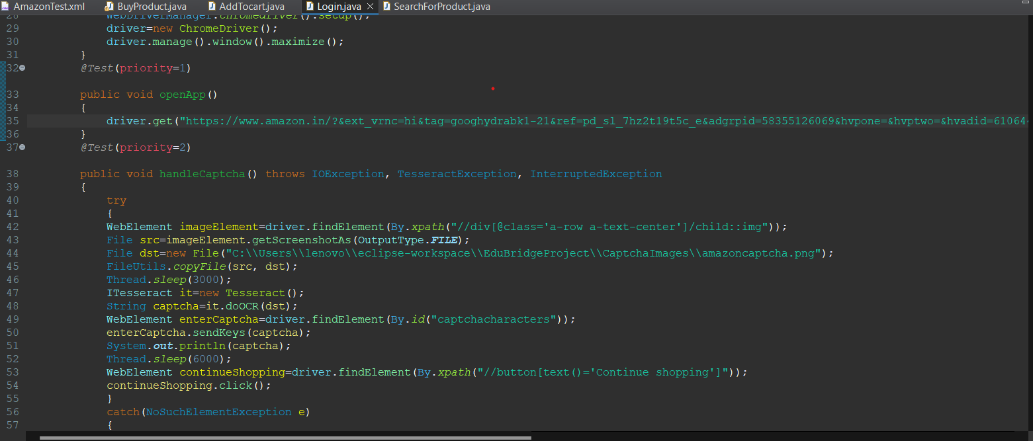
Login.java

Slide 6
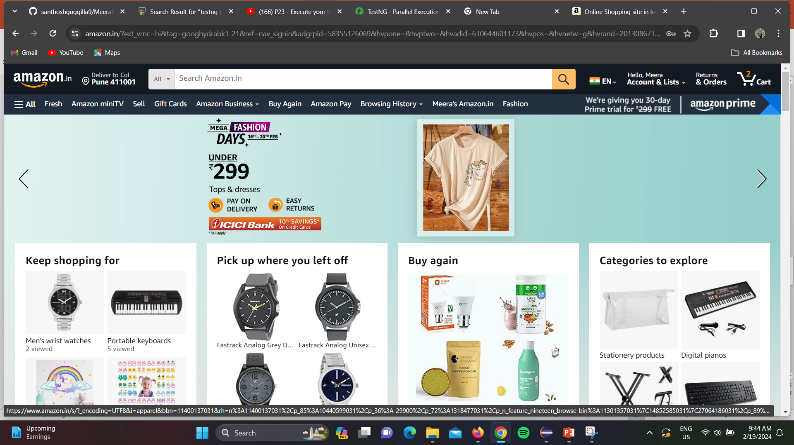
Login page displayed

Slide 7
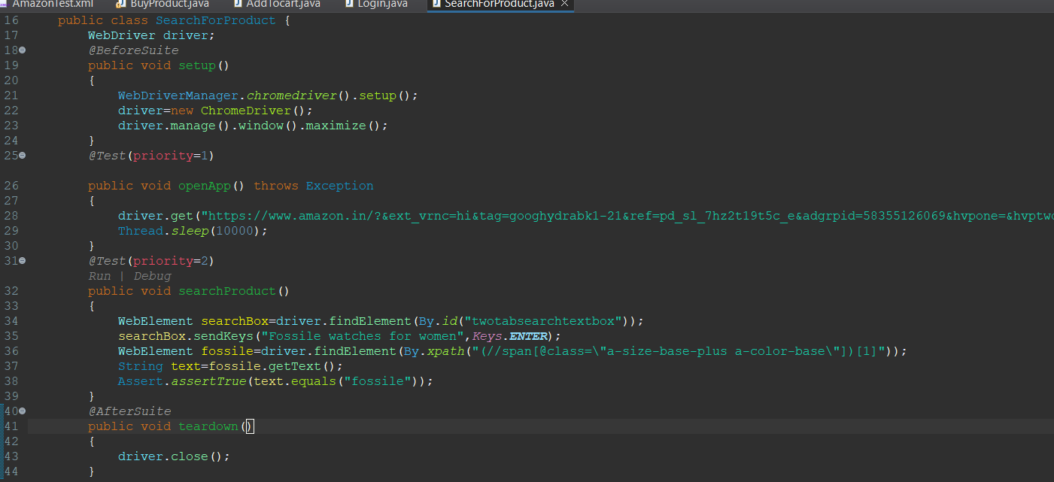
SearchForProduct

Slide 8

Search for product

Slide 9
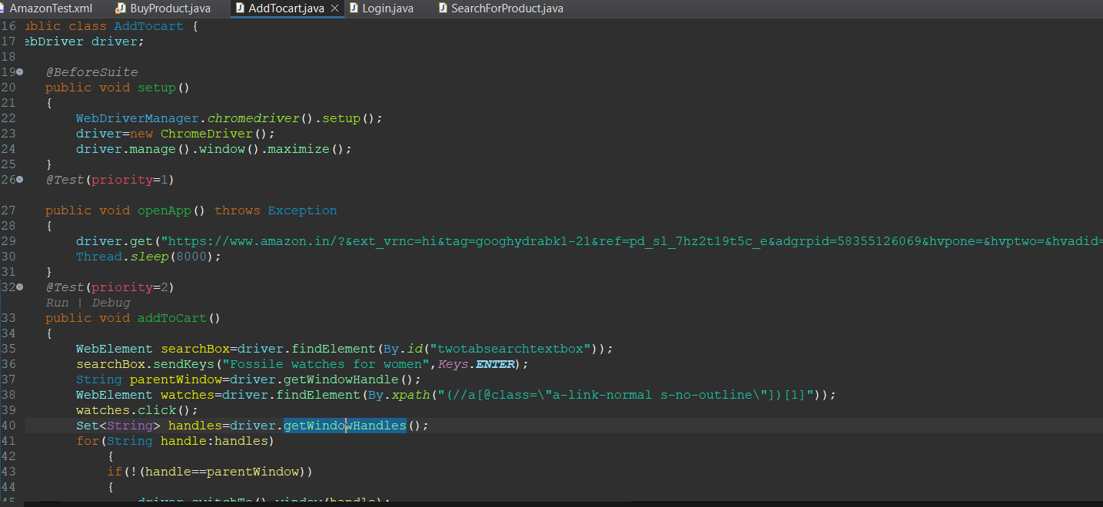
AddTocart

Slide 10
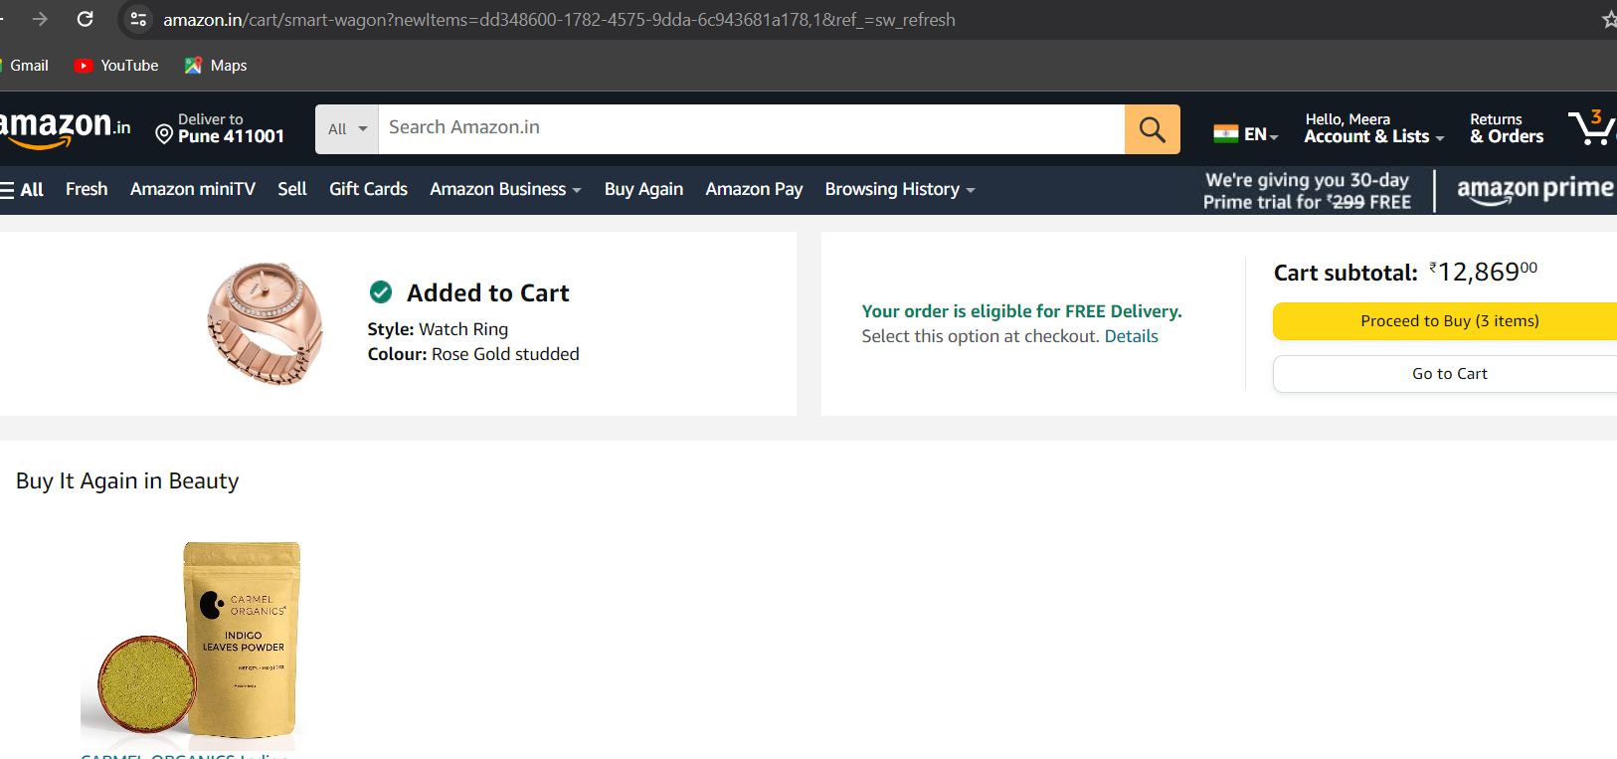
Add to cart

Slide 11
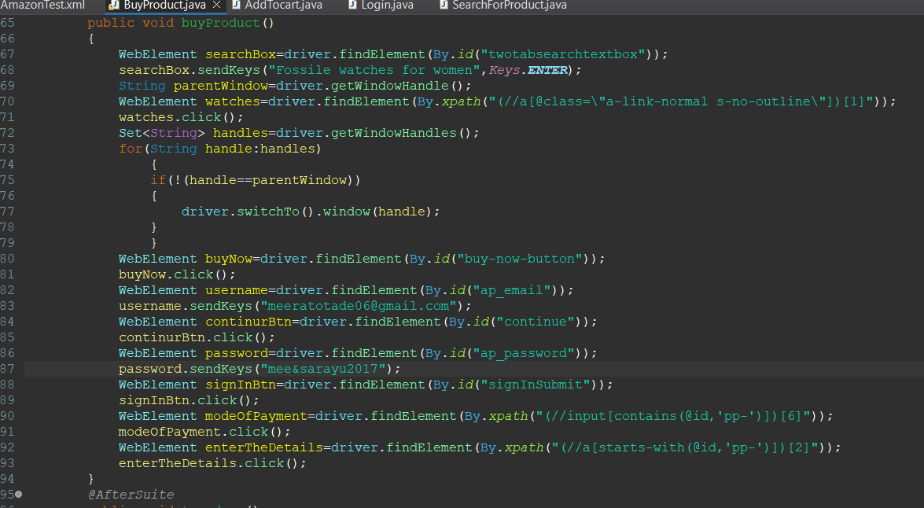
BuyProduct

Slide 12
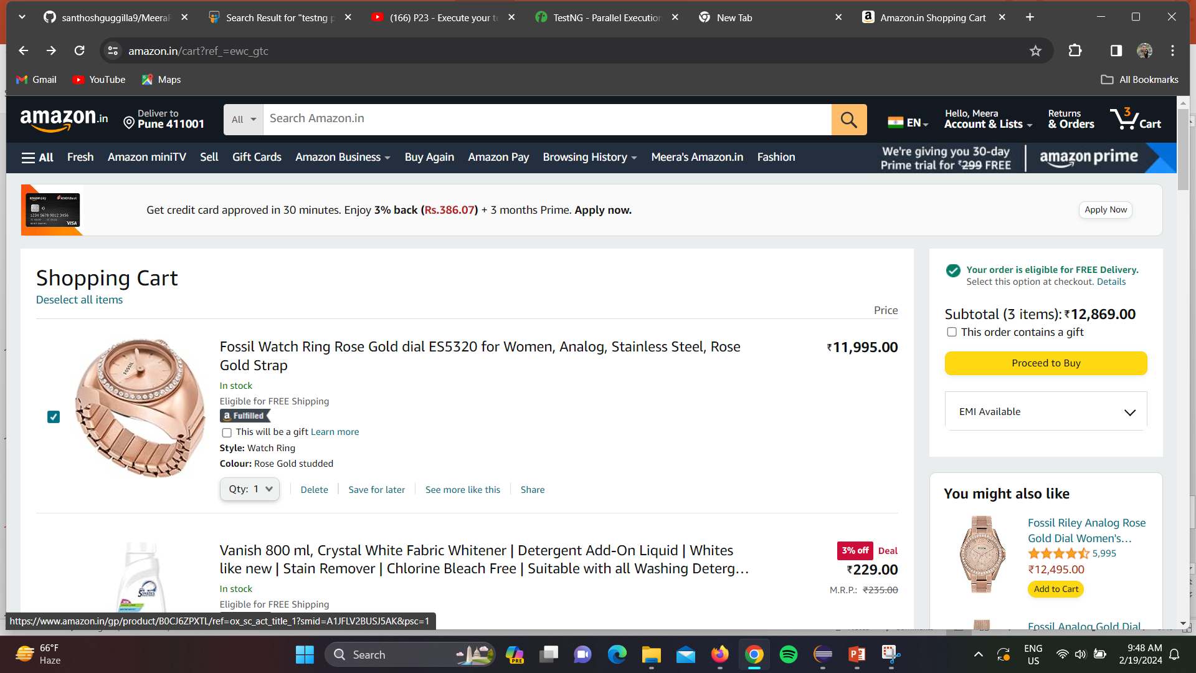
Buy product

Slide 13
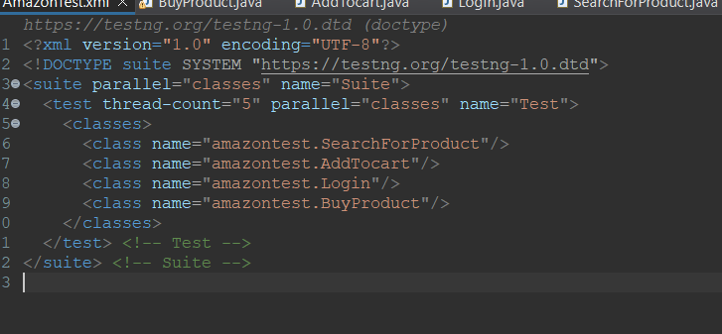
AmazonTest.xml

